Slide 1
WEARABLE JACKET WITH EMBEDDED SENSORS
Under guidance of
Mr. RAJASEKAR L,
EPD LAB INCHARGE,
BIT,
Sathy.
2021UEC1095& HARISH C
2021UEC1041& GOUTHAM K V
2021UEC1091& JAIPRASAD R
2021UEC1017& KARUPPUSAMY V

Slide 2
Abstract
Mining has always been one of the most dangerous occupations, and with the increased demand for coal and minerals, mine safety is becoming important. The hazards covered are accidents, dust (including poisoning by certain ores), high temperature and humidity, noise and vibration, toxic gases, and miscellaneous other hazards. White damp, also known as carbon monoxide (CO), is a particularly toxic gas; as little as 0.1 percent can result in death within minutes. It is a byproduct of incomplete carbon combustion and is formed primarily in coal mines by oxidation of coal, particularly in mines where spontaneous combustion occurs. FIRE DAMP -Methane Gas (CH4) is a highly explosive and noxious gas. It occurs naturally in coal seams and shale deposits and is a major component of natural gas, which we use to generate energy. A methane gas explosion killed six coal miners overnight in southwestern Baluchistan province near the Afghan border. To decrease the coal mine accident and ensure the worker's safety by monitoring the worker's physical condition and the external condition around them. By developing the wearable jacket with embedded sensors.
Keywords: Mining, dangerous, hazardous gases, Methane, explosive, ensure safety,
Developing, monitoring, physical condition, external condition, sensors.

Slide 3
Problem Statement Addressed
SENSORS EMBEDDED WITH WORK CLOTHING THAT DETECTS THE PHYSICAL CONDITION OF WORKERS AND ALSO THE EXTERNAL CONDITION IN COAL MINES WHICH SENDS DATA TO MANAGER.

Slide 4
Proposed Solution to the Problem Addressed
We use sensors namely, MAX30100Pulse OximeterHeart Rate Sensor Module,MLX90614 ESFNon-Contact Human BodyInfrared TemperatureMeasurement Module to detect the heartbeat and temperature of the workers in coal mine ,MQ2 Flammable Gas,
Smoke Sensor Module,BMP180Digital BarometricPressure Sensor Module to detect flammable gas (hazardous gas), and pressure in coal mine.
Also the hazardous gas is removed if the concentration of the firedamp or white damp is high.

Slide 5
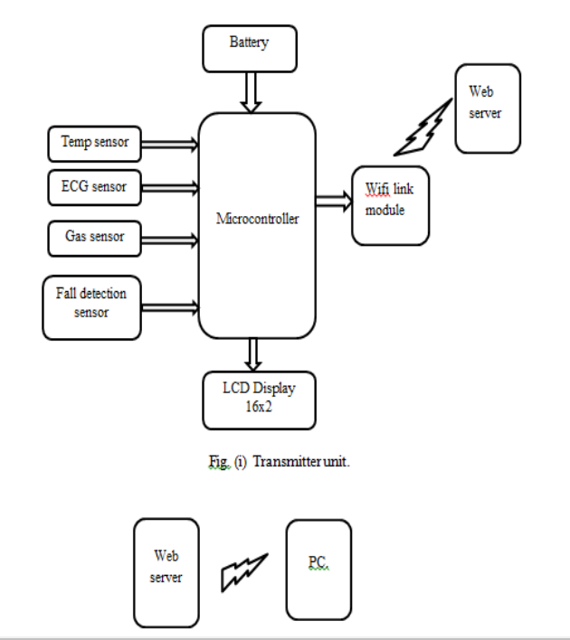
Block Diagram and/or Circuit Diagram

Slide 6
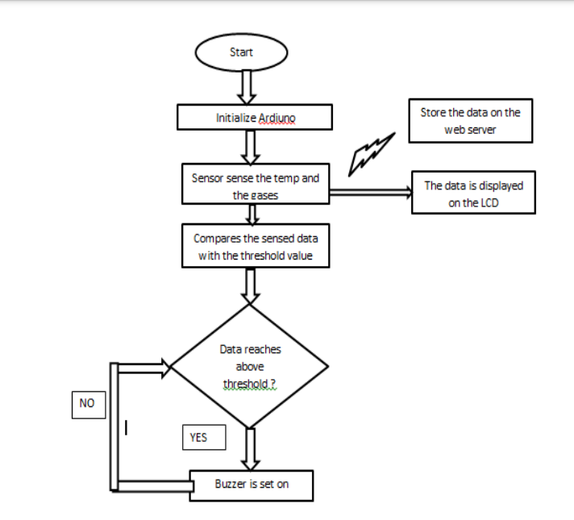
Flow Chart

Slide 7
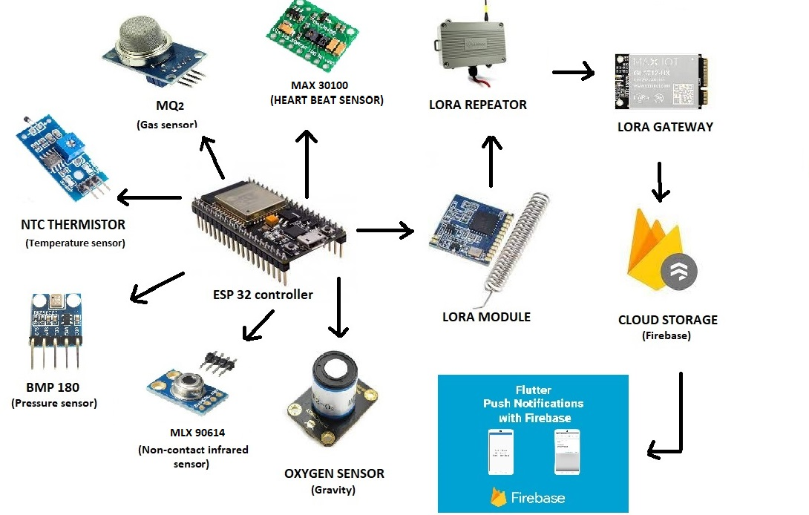
Technology stack & use case

Slide 8
Cost Benefit Analysis (List of Components / Service Used)
S.No | Component Name | Specification (IC number or Range or Value) | Unit Cost | Total Cost
1 | MAX30100 Pulse Oximeter Heart Rate Sensor Module | 97.11% and 98.84% accurate | Rs:160 | Rs:160
2 | MLX90614ESF | -40 to 85°C for the ambient temperature and -70 to 382.2°C for the object temperature. | Rs:840 | Rs:840
3 | MQ2 Flammable Gas and Smoke Sensor Module | 300 - 10000ppm | Rs:125 | Rs:125
4 | BMP180 Digital Barometric Pressure Sensor Module​ | 300 to 1100 hPa | Rs:300 | Rs:300
5 | LORA MODULE | 15 to 20 km | Rs:1500 | Rs:1500

Slide 9
References
Vladimir Konyukh ―Mine Planning Using RFID‖ Deploying RFID - Challenges, Solutions, and Open Issues chapter-10 ISBN 978-953-307-380-4 [2] Ge Bin LI Huizong ―The Research on ZigBee-Based Mine Safety Monitoring System‖ IEEE 2011 ISSN: 978- 1-4244-8039-5/11
Undram Chinbat (2011). Risk Analysis in the Mining Industry, Risk Management in Environment, Production and Economy, Dr. Matteo Savino (Ed.), ISBN: 978-953- 307-313-2

